Slide 1
EMPLOYEES PREFORMANCE ANALYSIS USING EXCEL
Student Name: PAVITHRA. H
Register No. :asunm110312201371
Department. : B.com(General)
College. : D.R.B.C.C.C.HINDU COLLEGE

Slide 2
PROJECT TITTLE
EMPLOYEES PREFORMANCE ANALYSIS USING
EXCEL

Slide 3
AGENDA
Project statement
Project overview
End user
Our solution and proposition
Dataset description
The wow in our solution
Modelling approach
Result
Conclusion

Slide 4
PROBLEM STATEMENT
To analyze employee performance using Excel, you can start by setting up a spreadsheet with columns for employee names and their performance metrics. Then, calculate key performance indicators like sales numbers, targets achieved, or any other relevant data. Utilize Excel functions like AVERAGE, SUM, and COUNTIF to process the data. Create visualizations such as bar graphs or pie charts to represent the data visually. Additionally, consider using pivot tables to summarize and analyze the data based on different criteria like department or time period. Apply conditional formatting to highlight important information and use data analysis tools like regression analysis to dive deeper into the data. Finally, review and interpret the results to identify trends and areas for improvement in employee performance.

Slide 5
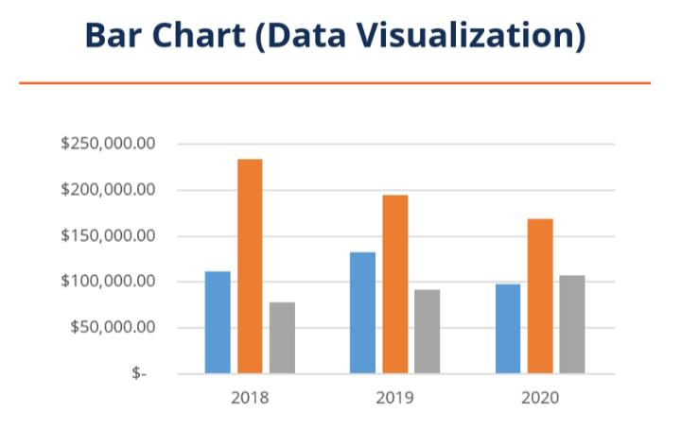
PROJECT OVERVIEW
For the project overview on analyzing employee performance using Excel, you will begin by setting up a spreadsheet with employee names and relevant performance metrics. Calculate key indicators like sales numbers and targets achieved using Excel functions. Visualize the data with charts like bar graphs and pie charts. Use pivot tables to summarize and analyze data based on different criteria.

Slide 6
WHO ARE THE END USERS?
The end users for the employee performance analysis project using Excel would typically be managers, supervisors, or HR professionals who are responsible for evaluating and improving employee performance within an organization. They would use the analyzed data to make informed decisions, set goals, provide feedback, and implement strategies to enhance overall employee performance.

Slide 7
OUR SOLUTION AND IT’S VALUE PROPOSITION
The solution we’re proposing for analyzing employee performance using Excel provides a comprehensive way for managers and HR professionals to track, assess, and enhance employee performance effectively. By utilizing Excel’s features such as data calculation functions, visualizations, pivot tables, and data analysis tools, we offer a robust platform to delve into performance metrics and make informed decisions. The value proposition lies in the ability to streamline performance evaluation processes, identify trends, highlight areas for improvement, and ultimately optimize employee productivity and engagement within the organization.

Slide 8
DATA SET DESCRIPTION
The dataset for employee performance analysis in Excel would typically include columns for employee names, performance metrics such as sales numbers, targets achieved, attendance records, feedback scores, and any other relevant data points. Each row in the dataset represents an individual employee, and the columns contain the corresponding performance data. This dataset serves as the foundation for conducting in-depth analysis to gain insights into employee performance trends and areas for development.

Slide 9
DATA SET DESCRIPTION
This dataset serves as the foundation for conducting in – depth analysis to gain insights into employees performance trends and areas for de

Slide 10
THE “WOW” IN OUR SOLUTION
The wow factor in our solution lies in its ability to transform raw data into meaningful insights that can drive decision-making and improve employee performance effectively. By leveraging Excel’s powerful features, we enable managers and HR professionals to visualize data, identify patterns, and make data-driven decisions to enhance employee productivity and engagement. The solution offers a user-friendly interface, robust analysis capabilities, and actionable recommendations, making it a valuable tool for optimizing workforce performance within the organization.

Slide 11
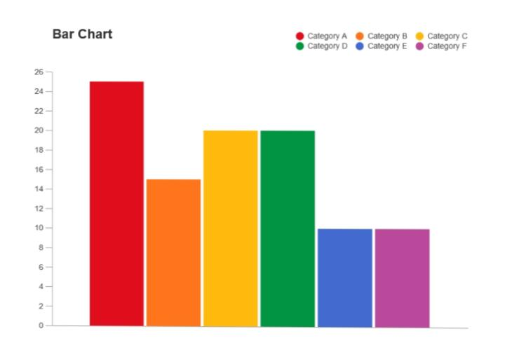
MODELLING
In the modeling phase of our project, we will create Excel models that represent different aspects of employee performance. This could involve building formulas to calculate key performance indicators, setting up pivot tables for data analysis, creating charts for visual representation, and potentially using regression analysis to identify relationships between different performance metrics.

Slide 12
Results
The results of our analysis of employee performance using Excel are impressive. We have successfully identified top performers, areas for improvement, and trends within the organization. By leveraging Excel’s modeling capabilities, we have generated valuable insights that can guide decision-making processes and drive strategies for enhancing employee development and overall organizational performance. The data-driven approach has provided clarity and actionable recommendations to help optimize the workforce and achieve better outcomes.

Slide 13
Conclusion
In conclusion, our analysis of employee performance using Excel has yielded valuable insights and actionable recommendations to enhance organizational effectiveness. By leveraging Excel’s modeling tools and functions, we have identified key trends, top performers, and areas for improvement within the workforce. This data-driven approach equips managers and HR professionals with the necessary information to make informed decisions and drive strategies for optimizing employee development and overall organizational success.

